Slide 1
Partner Technical Boot Camp
Alex Mang

Slide 2
Designing for Scale with Azure Messaging
Alex Mang

Slide 3
Agenda
What Is Messaging?
What Problem Does Messaging Solve?
Events vs. Messages
Choosing A Messaging Service
Messaging Cloud Design Patterns

Slide 4
What Is Messaging?

Slide 5
Communication
How do we move information between systems?
Direct | Brokered | Broadcast
Moving events between two endpoints | Moving events via communication middleware | Distribution of events from one source to anyone interested
“Phone” | “Mail” | “Radio”

Slide 6
A
B
Transfer
Messaging is all about getting data from here to there.
(Getting data back from there to here is the very same thing, in fact)

Slide 7
A
A
A
A
A
B
A
A
A
A
Transfer
A
A
A
A
A
A
A
A
Sometimes there’s a lot of “here”

Slide 8
Transfer
A
B
Sometimes there’s A LOT of data

Slide 9
B
B
B
A
B
B
B
B
Transfer
B
B
B
B
B
B
B
Sometimes there’s a lot of “there”

Slide 10
C
E
B
A
D
H
F
G
Transfer
I
J
K
N
L
O
M
Sometimes the “there” are all different

Slide 11
A
B
Transfer
Sometimes “there” isn’t currently paying attention

Slide 12
A
B
Transfer
Sometimes “there” is VERY BUSY

Slide 13
A
B
Transfer
Sometimes there’s trouble

Slide 14
What Problem Does Messaging Solve?

Slide 15
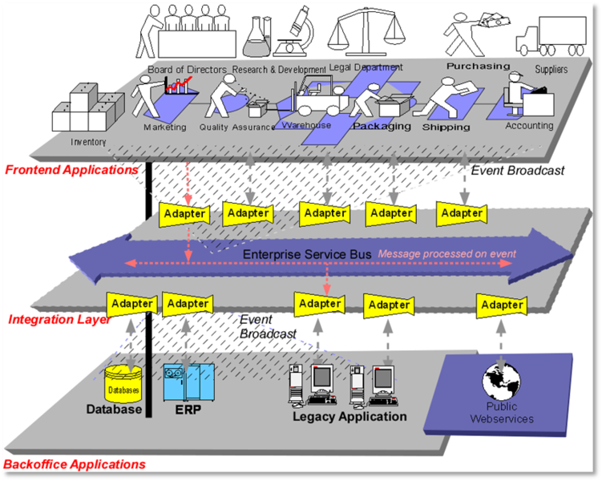
The API Gateway Pattern (nee Enterprise Service Bus)

Slide 16
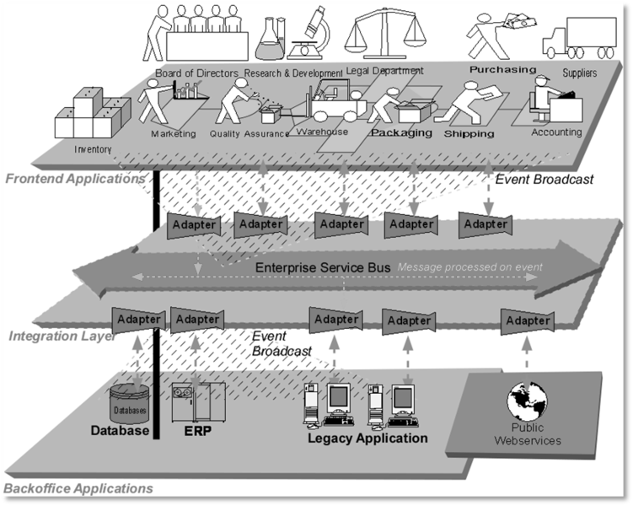
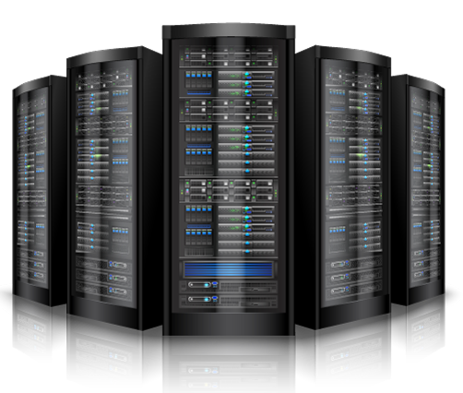
The Bus That’s a Hub
The reality of the “bus” → it’s a hub
n-way cluster with centralized repository
Challenges: scalability, connectivity, HA/Geo/DR, Cost, repository complexity

Slide 17
Some API Gateway and ESB Promises
The ESB Model promised simplification through centralization
Centralized Deployment and Config of Integration Logic Through Adapters
LOB
LOB
LOB
LOB
Centralized Service Governance, Monitoring and Analytics
Governance
Policies
LOB integration layer
LOB integration layer
LOB integration layer
LOB integration layer
Adapter
Adapter
Adapter
Adapter
Governance and
Analytics
Analytics
Store
Centralized Management of Information Routing, Orchestration and Transformation
Enterprise
Service Bus
Routing
Transformation
Orchestration
Routing and Configuration Repository
Schema and Transformation Repository
Orchestration and Process State Store
Centralized Repos for Management of Shared Assets

Slide 18
The Centralization Dilemma
At scale, many ESB/APIG advantages & benefits become weaknesses
Deployment Challenges: Versioning, Distribution, Release Coordination, Platform Dependencies
LOB
LOB
LOB
LOB
Shared Management Challenges: Config versioning, Governance, Exceptions, Test, Permissions
Governance
Policies
LOB integration layer
LOB integration layer
LOB integration layer
LOB integration layer
Adapter
Adapter
Adapter
Adapter
Governance and
Analytics
Analytics
Store
Scalability Challenges: scale-out, replication, consistency, Data volume
Enterprise
Service Bus
Routing
Transformation
Orchestration
Routing and Configuration Repository
Schema and Transformation Repository
Orchestration and Process State Store
Availability Challenges: geo-distribution, Disaster Recovery, No Downtime Upgrades

Slide 19
More Centralization Challenges - Ownership
Who owns these?
LOB
LOB
LOB
LOB
Governance
Policies
LOB integration layer
LOB integration layer
LOB integration layer
LOB integration layer
Adapter
Adapter
Adapter
Adapter
Governance and
Analytics
Analytics
Store
Enterprise
Service Bus
Routing
Transformation
Orchestration
Routing and Configuration Repository
Schema and Transformation Repository
Orchestration and Process State Store

Slide 20
Services Are Autonomous Entities
Defining property of services is that they’re Autonomous
A service owns all of the state it immediately depends on and manages
A service owns its communication contract
A service can be changed, redeployed, and/or completely replaced
A service has a well-known set of communication paths
Services shall have no shared state with others
Don't depend on or assume any common data store
Don't depend on any shared in-memory state
No sideline communications between services
No opaque side-effects
All communication is explicit
Autonomy is about agility and cross-org collaboration

Slide 21
Interdependencies
An autonomous service owns its own uptime
If a downstream dependency service is unavailable, it may be acceptable to partially degrade capability, but it’s not acceptable to go down blaming others
Any critical downstream dependencies need to be highly available, with provisions for disaster recovery
A service can rely on a highly-available messaging middleware layer as a gateway to allow for variable load or servicing needs
An autonomous service honors its contract
Version N honors the contract of Version N-1. Contracts are assurances!
Deprecation of a contract breaks dependents; have a clear policy

Slide 22
Shared Data Is A Bad Idea
Assumptions about share data store
Can’t switch data store independently
A
B
T
T
T
Data
Data
Store data, retrieve token (“primary key”)
Pass token, retrieve data

Slide 23
Data Store Decoupling Enables Evolution
A
B
Data schema V1
Data schema V1

Slide 24
Events vs. Messages
Notes:
https://docs.microsoft.com/en-us/azure/event-grid/compare-messaging-services#event-vs-message-services

Slide 25
Important Distinction
Event
Lightweight by design
Notification of a condition or state change
No expectation of how the event is handled
Can be discrete parts of a series
Time-ordered and interrelated
Message
Raw data produced by a service
Purposed to be consumed and stored elsewhere
Contains that about the trigger
Publisher has an expectation on how the consumer will handle it
Notes:
There's an important distinction to note between services that deliver an event and services that deliver a message.
Event
An event is a lightweight notification of a condition or a state change. The publisher of the event has no expectation about how the event is handled. The consumer of the event decides what to do with the notification. Events can be discrete units or part of a series.
Discrete events report state change and are actionable. To take the next step, the consumer only needs to know that something happened. The event data has information about what happened but doesn't have the data that triggered the event. For example, an event notifies consumers that a file was created. It may have general information about the file, but it doesn't have the file itself. Discrete events are ideal for serverless solutions that need to scale.
Series events report a condition and are analyzable. The events are time-ordered and interrelated. The consumer needs the sequenced series of events to analyze what happened.
Message
A message is raw data produced by a service to be consumed or stored elsewhere. The message contains the data that triggered the message pipeline. The publisher of the message has an expectation about how the consumer handles the message. A contract exists between the two sides. For example, the publisher sends a message with the raw data, and expects the consumer to create a file from that data and send a response when the work is done.

Slide 26
Messaging
Expectations
Conversations
Contracts
Control Transfer
Value Transfer
Eventing
History
Context
Order
Intents
Facts

Slide 27
Messaging
Often: one message, one receiver
Eventing
Often: One event, 0 to many receivers
B
B
B
?
C
?

Slide 28
Choose A Messaging Service
Notes:
https://docs.microsoft.com/en-us/azure/architecture/guide/technology-choices/messaging

Slide 29
Azure Messaging Services Compared
Service | Purpose | Type | When to use
Event Grid | Reactive programming | Event distribution (discrete) | React to status changes
Event Hubs | Big data pipeline | Event streaming (series) | Telemetry and distributed data streaming
Service Bus | High-value enterprise messaging | Message | Order processing and financial transactions

Slide 30
Event Grid
Eventing backplane for event-driven (reactive) programming
Pub/sub model
Integrated with Azure services
Characteristics:
Dynamically scalable
Low cost
Serverless
At least once delivery
Notes:
Event Grid is an eventing backplane that enables event-driven, reactive programming. It uses a publish-subscribe model. Publishers emit events, but have no expectation about which events are handled. Subscribers decide which events they want to handle.
Event Grid is deeply integrated with Azure services and can be integrated with third-party services. It simplifies event consumption and lowers costs by eliminating the need for constant polling. Event Grid efficiently and reliably routes events from Azure and non-Azure resources. It distributes the events to registered subscriber endpoints. The event message has the information you need to react to changes in services and applications. Event Grid isn't a data pipeline, and doesn't deliver the actual object that was updated.
Event Grid supports dead-lettering for events that aren't delivered to an endpoint.
It has the following characteristics:
dynamically scalable
low cost
serverless
at least once delivery

Slide 31
Event Hubs
Big-data pipeline
Capture, retention and replay of stream data
Characteristics:
Low latency
Mil. events/second
At least once delivery
Notes:
Azure Event Hubs is a big data pipeline. It facilitates the capture, retention, and replay of telemetry and event stream data. The data can come from many concurrent sources.
Event Hubs allows telemetry and event data to be made available to a variety of stream-processing infrastructures and analytics services. It is available either as data streams or bundled event batches. This service provides a single solution that enables rapid data retrieval for real-time processing as well as repeated replay of stored raw data. It can capture the streaming data into a file for processing and analysis.
It has the following characteristics:
low latency
capable of receiving and processing millions of events per second
at least once delivery

Slide 32
Service Bus
Traditional messaging for enterprise apps
Reliable state transition management
Characteristics:
Reliability
Advanced messaging features
At least once/at most once
In-order delivery
Notes:
Service Bus is intended for traditional enterprise applications. These enterprise applications require transactions, ordering, duplicate detection, and instantaneous consistency. Service Bus enables cloud-native applications to provide reliable state transition management for business processes. When handling high-value messages that cannot be lost or duplicated, use Azure Service Bus. Service Bus also facilitates highly secure communication across hybrid cloud solutions and can connect existing on-premises systems to cloud solutions.
Service Bus is a brokered messaging system. It stores messages in a "broker" (for example, a queue) until the consuming party is ready to receive the messages.
It has the following characteristics:
reliable asynchronous message delivery (enterprise messaging as a service) that requires polling
advanced messaging features like FIFO, batching/sessions, transactions, dead-lettering, temporal control, routing and filtering, and duplicate detection
at least once delivery
optional in-order delivery

Slide 33
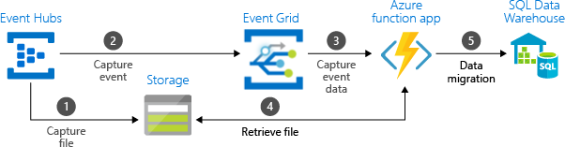
Use The Services Together
Use the services side by side
Use the services linked together
Notes:
In some cases, you use the services side by side to fulfill distinct roles. For example, an e-commerce site can use Service Bus to process the order, Event Hubs to capture site telemetry, and Event Grid to respond to events like an item was shipped.
In other cases, you link them together to form an event and data pipeline. You use Event Grid to respond to events in the other services. For an example of using Event Grid with Event Hubs to migrate data to a data warehouse, see Stream big data into a data warehouse. The following image shows the workflow for streaming the data.

Slide 34
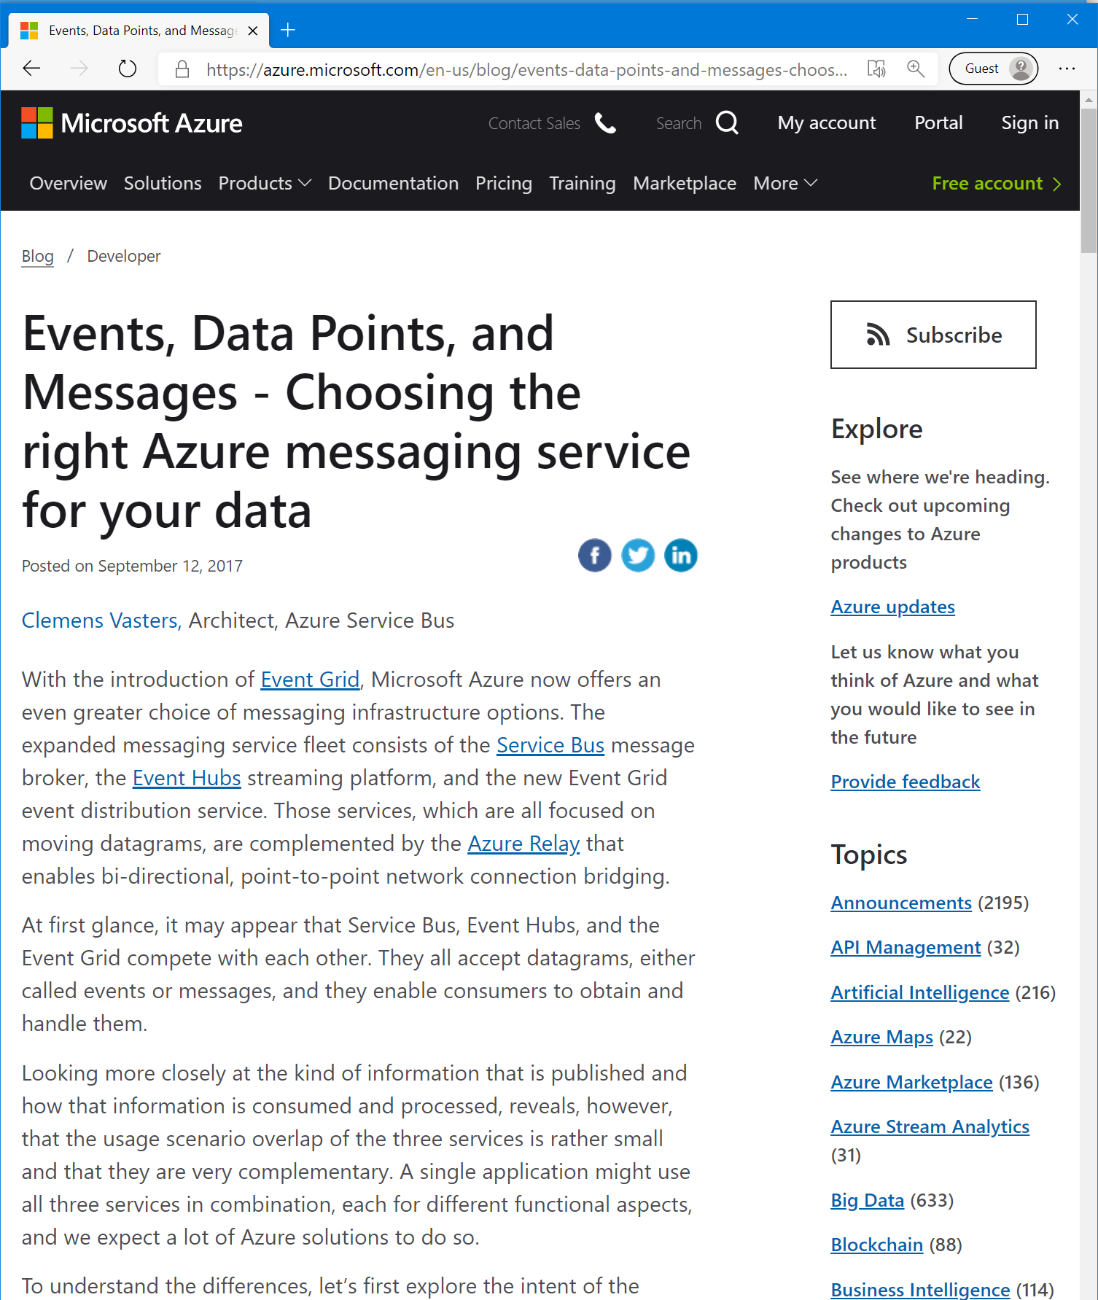
Good Read On This Topic
https://azure.microsoft.com/en-us/blog/events-data-points-and-messages-choosing-the-right-azure-messaging-service-for-your-data/

Slide 35
Related Cloud Design Patterns
Notes:
The distributed nature of cloud applications requires a messaging infrastructure that connects the components and services, ideally in a loosely coupled manner in order to maximize scalability. Asynchronous messaging is widely used, and provides many benefits, but also brings challenges such as the ordering of messages, poison message management, idempotency, and more.

Slide 36
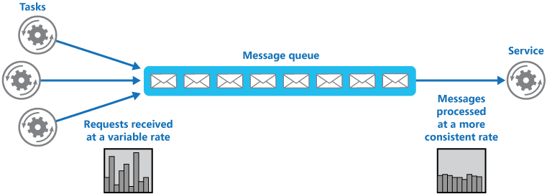
Competing-Consumers Pattern
Problem
High load, flooding and variable request rates drive lack of performance
Solution
Introduce a queue in between
Notes:
Context and problem
Many solutions in the cloud involve running tasks that invoke services. In this environment, if a service is subjected to intermittent heavy loads, it can cause performance or reliability issues.
A service could be part of the same solution as the tasks that use it, or it could be a third-party service providing access to frequently used resources such as a cache or a storage service. If the same service is used by a number of tasks running concurrently, it can be difficult to predict the volume of requests to the service at any time.
A service might experience peaks in demand that cause it to overload and be unable to respond to requests in a timely manner. Flooding a service with a large number of concurrent requests can also result in the service failing if it's unable to handle the contention these requests cause.
Solution
Refactor the solution and introduce a queue between the task and the service. The task and the service run asynchronously. The task posts a message containing the data required by the service to a queue. The queue acts as a buffer, storing the message until it's retrieved by the service. The service retrieves the messages from the queue and processes them. Requests from a number of tasks, which can be generated at a highly variable rate, can be passed to the service through the same message queue. This figure shows using a queue to level the load on a service.
The queue decouples the tasks from the service, and the service can handle the messages at its own pace regardless of the volume of requests from concurrent tasks. Additionally, there's no delay to a task if the service isn't available at the time it posts a message to the queue.
This pattern provides the following benefits:
It can help to maximize availability because delays arising in services won't have an immediate and direct impact on the application, which can continue to post messages to the queue even when the service isn't available or isn't currently processing messages.
It can help to maximize scalability because both the number of queues and the number of services can be varied to meet demand.
It can help to control costs because the number of service instances deployed only have to be adequate to meet average load rather than the peak load.
Issues and considerations
Consider the following points when deciding how to implement this pattern:
It's necessary to implement application logic that controls the rate at which services handle messages to avoid overwhelming the target resource. Avoid passing spikes in demand to the next stage of the system. Test the system under load to ensure that it provides the required leveling, and adjust the number of queues and the number of service instances that handle messages to achieve this.
Message queues are a one-way communication mechanism. If a task expects a reply from a service, it might be necessary to implement a mechanism that the service can use to send a response. For more information, see the Asynchronous Messaging Primer.
Be careful if you apply autoscaling to services that are listening for requests on the queue. This can result in increased contention for any resources that these services share and diminish the effectiveness of using the queue to level the load.

Slide 37
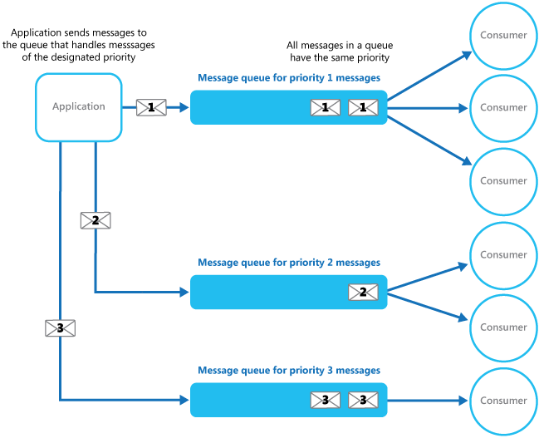
Priority Queue pattern
Problem
Sometimes a message is more important than another
Solution
Priority-based queues/subscriptions
Notes:
Context and Problem
Applications can delegate specific tasks to other services, for example, to perform background processing or to integrate with other applications or services. In the cloud, a message queue is typically used to delegate tasks to background processing. In many cases the order requests are received in by a service isn't important. In some cases, though, it's necessary to prioritize specific requests. These requests should be processed earlier than lower priority requests that were sent previously by the application.
Solution
A queue is usually a first-in, first-out (FIFO) structure, and consumers typically receive messages in the same order that they were posted to the queue. However, some message queues support priority messaging. The application posting a message can assign a priority and the messages in the queue are automatically reordered so that those with a higher priority will be received before those with a lower priority. The figure illustrates a queue with priority messaging.
In systems that don't support priority-based message queues, an alternative solution is to maintain a separate queue for each priority. The application is responsible for posting messages to the appropriate queue. Each queue can have a separate pool of consumers. Higher priority queues can have a larger pool of consumers running on faster hardware than lower priority queues. The next figure illustrates using separate message queues for each priority.
A variation on this strategy is to have a single pool of consumers that check for messages on high priority queues first, and only then start to fetch messages from lower priority queues. There are some semantic differences between a solution that uses a single pool of consumer processes (either with a single queue that supports messages with different priorities or with multiple queues that each handle messages of a single priority), and a solution that uses multiple queues with a separate pool for each queue.
In the single pool approach, higher priority messages are always received and processed before lower priority messages. In theory, messages that have a very low priority could be continually superseded and might never be processed. In the multiple pool approach, lower priority messages will always be processed, just not as quickly as those of a higher priority (depending on the relative size of the pools and the resources that they have available).

Slide 38
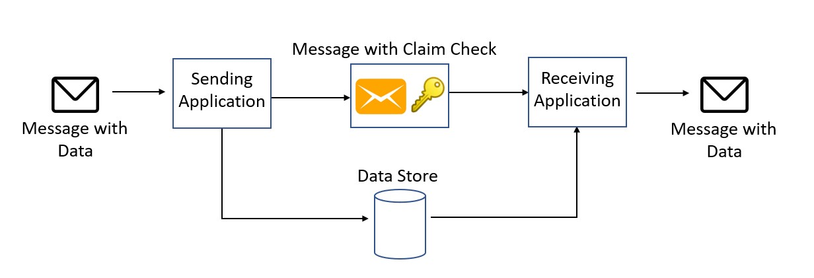
Claim-Check Pattern
Problem
Sending large message payloads
Solution
Use external data storage solution
Send a reference to the consumer
Notes:
Context and problem
A messaging-based architecture at some point must be able to send, receive, and manipulate large messages. Such messages may contain anything, including images (for example, MRI scans), sound files (for example, call-center calls), text documents, or any kind of binary data of arbitrary size.
Sending such large messages to the message bus directly is not recommended, because they require more resources and bandwidth to be consumed. Large messages can also slow down the entire solution, because messaging platforms are usually fine-tuned to handle huge quantities of small messages. Also, most messaging platforms have limits on message size, so you may need to work around these limits for large messages.
Solution
Store the entire message payload into an external service, such as a database. Get the reference to the stored payload, and send just that reference to the message bus. The reference acts like a claim check used to retrieve a piece of luggage, hence the name of the pattern. Clients interested in processing that specific message can use the obtained reference to retrieve the payload, if needed.
When to use this pattern
This pattern should be used whenever a message cannot fit the supported message limit of the chosen message bus technology. For example, Event Hubs currently has a limit of 256 KB (Basic Tier), while Event Grid supports only 64-KB messages.
The pattern can also be used if the payload should be accessed only by services that are authorized to see it. By offloading the payload to an external resource, stricter authentication and authorization rules can be put in place, to ensure that security is enforced when sensitive data is stored in the payload.

Slide 39
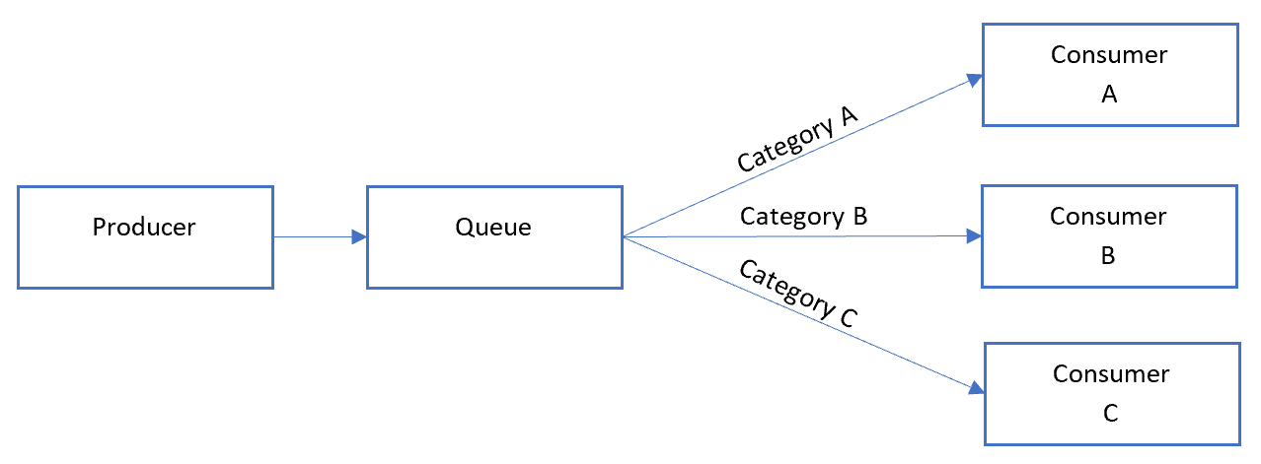
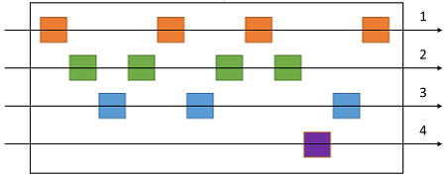
Sequential Convoy Pattern
Problem
Process messages in order
Also handle increased load
Solution
Groups messages together within the queuing system
Notes:
Context and problem
Applications often need to process a sequence of messages in the order they arrive, while still being able to scale out to handle increased load. In a distributed architecture, processing these messages in order is not straightforward, because the workers can scale independently and often pull messages independently, using a Competing Consumers pattern.
For example, an order tracking system receives a ledger containing orders and the relevant operations on those orders. These operations could be to create an order, add a transaction to the order, modify a past transaction, or delete an order. In this system, operations must be performed in a first-in-first-out (FIFO) manner, but only at the order level. However, the initial queue receives a ledger containing transactions for many orders, which may be interleaved.
Solution
Push related messages into categories within the queuing system, and have the queue listeners lock and pull only from one category, one message at a time.
In the queue, messages for different categories may be interleaved, as shown in the diagram.
When to use this pattern
Use this pattern when:
You have messages that arrive in order and must be processed in the same order.
Arriving messages are or can be "categorized" in such a way that the category becomes a unit of scale for the system.
This pattern might not be suitable for:
Extremely high throughput scenarios (millions of messages/minute or second), as the FIFO requirement limits the scaling that can be done by the system.

Slide 40
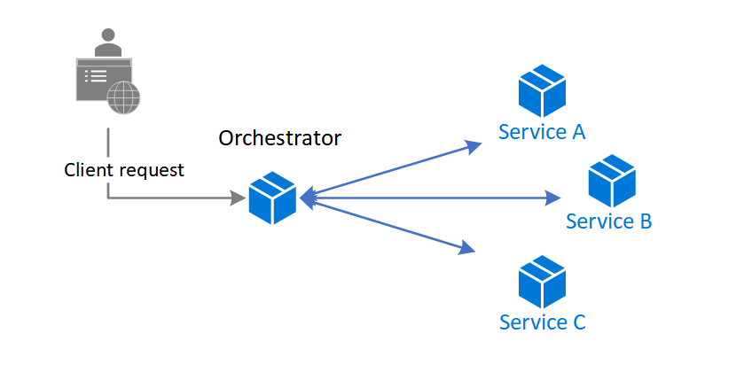
Choreography Pattern
Problem
Orchestrator pattern creates tight-coupling
Developers inject domain knowledge in the orchestrator
New services force the orchestrator to update
Notes:
Context and problem
In microservices architecture, it’s often the case that a cloud-based application is divided into several small services that work together to process a business transaction end-to-end. To lower coupling between services, each service is responsible for a single business operation. Some benefits include faster development, smaller code base, and scalability. However, designing an efficient and scalable workflow is a challenge and often requires complex interservice communication.
The services communicate with each other by using well-defined APIs. Even a single business operation can result in multiple point-to-point calls among all services. A common pattern for communication is to use a centralized service that acts as the orchestrator. It acknowledges all incoming requests and delegates operations to the respective services. In doing so, it also manages the workflow of the entire business transaction. Each service just completes an operation and is not aware of the overall workflow.
The orchestrator pattern reduces point-to-point communication between services but has some drawbacks because of the tight coupling between the orchestrator and other services that participate in processing of the business transaction. To execute tasks in a sequence, the orchestrator needs to have some domain knowledge about the responsibilities of those services. If you want to add or remove services, existing logic will break, and you'll need to rewire portions of the communication path. While you can configure the workflow, add or remove services easily with a well-designed orchestrator, such an implementation is complex and hard to maintain.

Slide 41
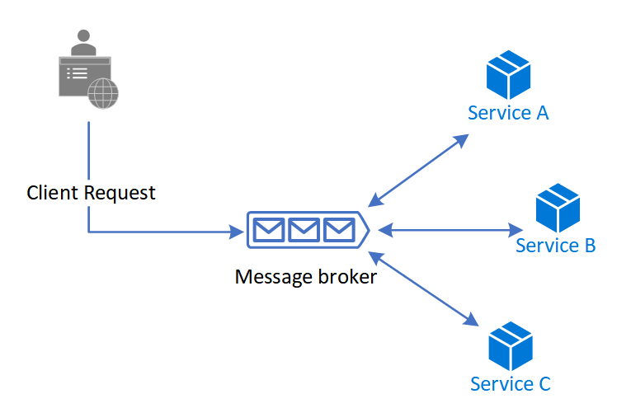
Choreography Pattern (cont’d)
Solution
Enforce eventual-consistency by implementing n communication busses
Workflows are split into signals and busses
Notes:
Let each service decide when and how a business operation is processed, instead of depending on a central orchestrator.
One way to implement choreography is to use the asynchronous messaging pattern to coordinate the business operations.
A client request publishes messages to a message queue. As messages arrive, they are pushed to subscribers, or services, interested in that message. Each subscribed service does their operation as indicated by the message and responds to the message queue with success or failure of the operation. In case of success, the service can push a message back to the same queue or a different message queue so that another service can continue the workflow if needed. If an operation fails, the message bus can retry that operation.
This way, the services choreograph the workflow among themselves without depending on an orchestrator or having direct communication between them.
Because there isn't point-to-point communication, this pattern helps reduce coupling between services. Also, it can remove the performance bottleneck caused by the orchestrator when it has to deal with all transactions.
Issues and considerations
Decentralizing the orchestrator can cause issues while managing the workflow.
If a service fails to complete a business operation, it can be difficult to recover from that failure. One way is to have the service indicate failure by firing an event. Another service subscribes to those failed events takes necessary actions such as applying compensating transactions to undo successful operations in a request. The failed service might also fail to fire an event for the failure. In that case, consider using a retry and, or time out mechanism to recognize that operation as a failure. For an example, see the Example section.
It's simple to implement a workflow when you want to process independent business operations in parallel. You can use a single message bus. However, the workflow can become complicated when choreography needs to occur in a sequence. For instance, Service C can start its operation only after Service A and Service B have completed their operations with success. One approach is to have multiple message buses that get messages in the required order. For more information, see the Example section.
The choreography pattern becomes a challenge if the number of services grow rapidly. Given the high number of independent moving parts, the workflow between services tends to get complex. Also, distributed tracing becomes difficult.
The orchestrator centrally manages the resiliency of the workflow and it can become a single point of failure. On the other hand, for choreography, the role is distributed between all services and resiliency becomes less robust.
Each service isn't only responsible for the resiliency of its operation but also the workflow. This responsibility can be burdensome for the service and hard to implement. Each service must retry transient, nontransient, and time-out failures, so that the request terminates gracefully, if needed. Also, the service must be diligent about communicating the success or failure of the operation so that other services can act accordingly.

Slide 42
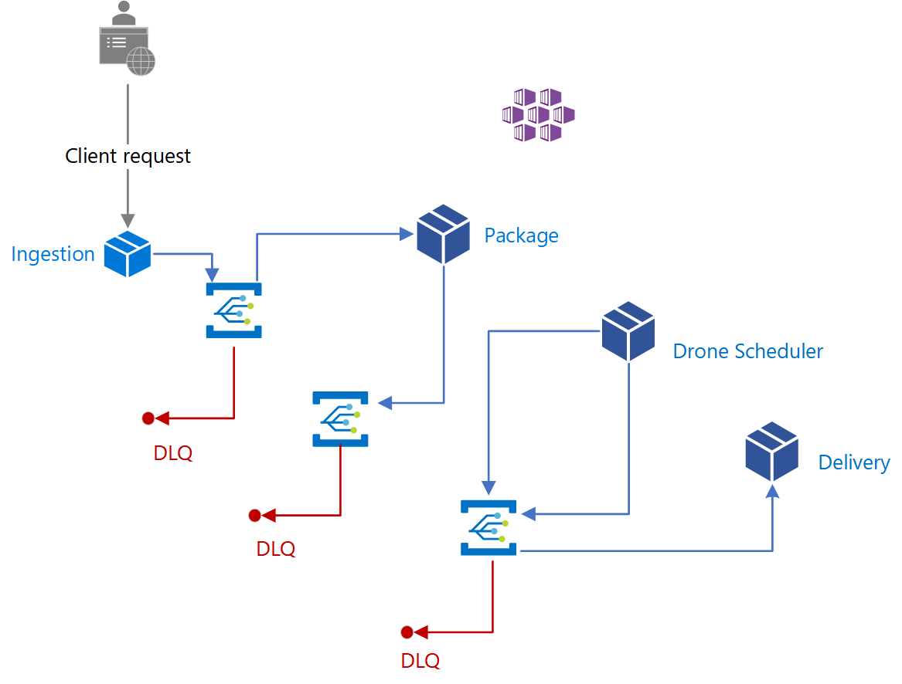
Choreography Pattern Example
Notes:
A single client business transaction requires three distinct business operations: creating or updating a package, assigning a drone to deliver the package, and checking the delivery status. Those operations are performed by three microservices: Package, Drone Scheduler, and Delivery services. Instead of a central orchestrator, the services use messaging to collaborate and coordinate the request among themselves
The business transaction is processed in a sequence through multiple hops. Each hop has a message bus and the respective business service.
When a client sends a delivery request through an HTTP endpoint, the Ingestion service receives it, raises an operation event, and sends it to a message bus. The bus invokes the subscribed business service and sends the event in a POST request. On receiving the event, the business service can complete the operation with success, failure, or the request can time out. If successful, the service responds to the bus with the Ok status code, raises a new operation event, and sends it to the message bus of the next hop. In case of a failure or time-out, the service reports failure by sending the BadRequest code to the message bus that sent the original POST request. The message bus retries the operation based on a retry policy. After that period expires, message bus flags the failed operation and further processing of the entire request stops.
This workflow continues until the entire request has been processed.
The design uses multiple message buses to process the entire business transaction. Microsoft Azure Event Grid provides the messaging service. The app is deployed in an Azure Kubernetes Service (AKS) cluster with two containers in the same pod. One container runs the ambassador that interacts with Event Grid while the other runs a business service. The approach with two containers in the same pod improves performance and scalability. The ambassador and the business service share the same network allowing for low latency and high throughput.
To avoid cascading retry operations that might lead to multiple efforts, only Event Grid retries an operation instead of the business service. It flags a failed request by sending a messaging to a dead letter queue (DLQ).
The business services are idempotent to make sure retry operations don’t result in duplicate resources. For example, the Package service uses upsert operations to add data to the data store.

Slide 43
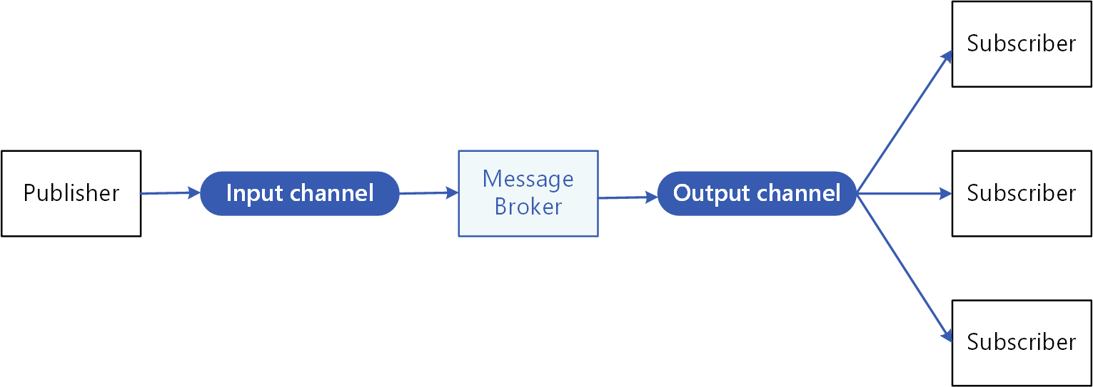
Pub/Sub Pattern (For Distributed Apps)
Problem
Services should not be aware of other services
Having services define their own queue goes against microservices principals
Solution
Messaging subsystem middleware
Notes:
Context and problem
In cloud-based and distributed applications, components of the system often need to provide information to other components as events happen.
Asynchronous messaging is an effective way to decouple senders from consumers, and avoid blocking the sender to wait for a response. However, using a dedicated message queue for each consumer does not effectively scale to many consumers. Also, some of the consumers might be interested in only a subset of the information. How can the sender announce events to all interested consumers without knowing their identities?
Solution
Introduce an asynchronous messaging subsystem that includes the following:
An input messaging channel used by the sender. The sender packages events into messages, using a known message format, and sends these messages via the input channel. The sender in this pattern is also called the publisher.
One output messaging channel per consumer. The consumers are known as subscribers.
A mechanism for copying each message from the input channel to the output channels for all subscribers interested in that message. This operation is typically handled by an intermediary such as a message broker or event bus.
The following diagram shows the logical components of this pattern:
Pub/sub messaging has the following benefits:
It decouples subsystems that still need to communicate. Subsystems can be managed independently, and messages can be properly managed even if one or more receivers are offline.
It increases scalability and improves responsiveness of the sender. The sender can quickly send a single message to the input channel, then return to its core processing responsibilities. The messaging infrastructure is responsible for ensuring messages are delivered to interested subscribers.
It improves reliability. Asynchronous messaging helps applications continue to run smoothly under increased loads and handle intermittent failures more effectively.
It allows for deferred or scheduled processing. Subscribers can wait to pick up messages until off-peak hours, or messages can be routed or processed according to a specific schedule.
It enables simpler integration between systems using different platforms, programming languages, or communication protocols, as well as between on-premises systems and applications running in the cloud.
It facilitates asynchronous workflows across an enterprise.
It improves testability. Channels can be monitored and messages can be inspected or logged as part of an overall integration test strategy.
It provides separation of concerns for your applications. Each application can focus on its core capabilities, while the messaging infrastructure handles everything required to reliably route messages to multiple consumers.
Issues and considerations
Consider the following points when deciding how to implement this pattern:
Existing technologies. It is strongly recommended to use available messaging products and services that support a publish-subscribe model, rather than building your own. In Azure, consider using Service Bus or Event Grid. Other technologies that can be used for pub/sub messaging include Redis, RabbitMQ, and Apache Kafka.
Subscription handling. The messaging infrastructure must provide mechanisms that consumers can use to subscribe to or unsubscribe from available channels.
Security. Connecting to any message channel must be restricted by security policy to prevent eavesdropping by unauthorized users or applications.
Subsets of messages. Subscribers are usually only interested in subset of the messages distributed by a publisher. Messaging services often allow subscribers to narrow the set of messages received by:
Topics. Each topic has a dedicated output channel, and each consumer can subscribe to all relevant topics.
Content filtering. Messages are inspected and distributed based on the content of each message. Each subscriber can specify the content it is interested in.
Wildcard subscribers. Consider allowing subscribers to subscribe to multiple topics via wildcards.
Bi-directional communication. The channels in a publish-subscribe system are treated as unidirectional. If a specific subscriber needs to send acknowledgment or communicate status back to the publisher, consider using the Request/Reply Pattern. This pattern uses one channel to send a message to the subscriber, and a separate reply channel for communicating back to the publisher.
Message ordering. The order in which consumer instances receive messages isn't guaranteed, and doesn't necessarily reflect the order in which the messages were created. Design the system to ensure that message processing is idempotent to help eliminate any dependency on the order of message handling.
Message priority. Some solutions may require that messages are processed in a specific order. The Priority Queue pattern provides a mechanism for ensuring specific messages are delivered before others.
Poison messages. A malformed message, or a task that requires access to resources that aren't available, can cause a service instance to fail. The system should prevent such messages being returned to the queue. Instead, capture and store the details of these messages elsewhere so that they can be analyzed if necessary.
Repeated messages. The same message might be sent more than once. For example, the sender might fail after posting a message. Then a new instance of the sender might start up and repeat the message. The messaging infrastructure should implement duplicate message detection and removal (also known as de-duping) based on message IDs in order to provide at-most-once delivery of messages.
Message expiration. A message might have a limited lifetime. If it isn't processed within this period, it might no longer be relevant and should be discarded. A sender can specify an expiration time as part of the data in the message. A receiver can examine this information before deciding whether to perform the business logic associated with the message.
Message scheduling. A message might be temporarily embargoed and should not be processed until a specific date and time. The message should not be available to a receiver until this time.

Slide 44
Wrap-up

Slide 45
Review
What Is Messaging?
What Problem Does Messaging Solve?
Events vs. Messages
Choosing A Messaging Service
Messaging Cloud Design Patterns

Slide 46
Thank you.

